Slide 1
Forensic Audio
TEJASVI BHATIA

Slide 2
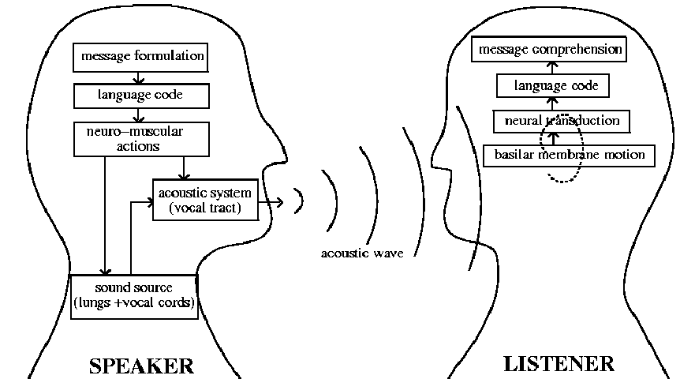
Speaker & Listener
Production of vibrational energy by articulation after brain instructs to perform.
Eardrums convert this vibrational energy into signals that travel along nerves to the brain, which interprets them as voices, music, noise, etc.

Slide 3
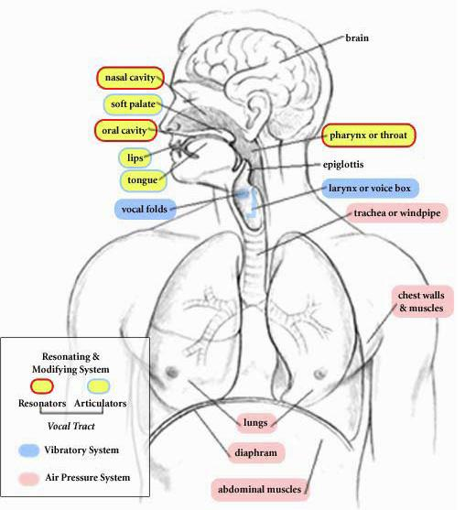
Production of speech
The basic responsible function for production of speech are: Generation of air pressure, regulation of vibration, and control of resonators
Larynx sometimes called voice box is the most important organ among Lung, Vocal code, pharynx, Tongue, Teeth & Lip etc.
Yes Tongue is also the valuable articulatory organ

Slide 4
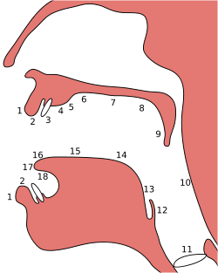
Place of articulation
Places of articulation :
1. Exo-labial,
2. Endo-labial,
3. Dental,
4. Alveolar,
5. Post-alveolar,
6. Pre-palatal,
7. Palatal,
8. Velar,
9. Uvular,
10. Pharyngeal,
11. Glottal,
12. Epiglottal,
13. Radical,
14. Postero-dorsal,
15. Antero-dorsal,
16. Laminal,
17. Apical,
18. Sub-apical

Slide 5
Why animal can’t produce speech
Except Human being, any other animals can’t produce speech because they don’t have co-articulation system
SOUND IS NOT CONTROLLED

Slide 6
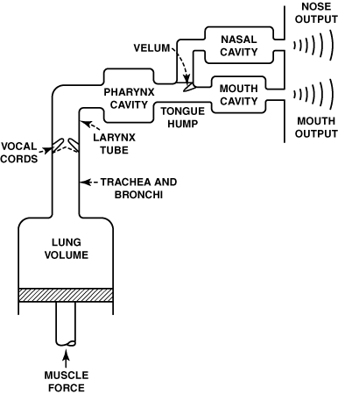
Why person to person different in voice
As vocal tracks are differ in shape, size and length and the tension of the vocal folds, the voice production is also different to person to person

Slide 7

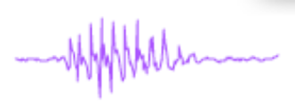
SPEAKER IDENTIFICATION
Words
Speech
recognition
Speech Signal
“Hello”
Speaker identity
Speaker
recognition
Mr. XXX

Slide 8
Speaker Recognition
The process of automatically recognizing who is speaking on the basis of individual’s speech signals information.
It is divided into two categories:
  Speaker Identification
    The task of determining an unknown speaker’s identity. (Speaker identification determines which registered speaker provides a given utterance from amongst a set of known speakers.)
  Speaker Verification
    With certain identity the voice is used to verify (Speaker verification accepts or rejects the identity claim of a speaker - is the speaker the person they say they are? )
In forensic applications, it is suggested to first perform a speaker identification process to create a list of "best matches" and then perform a series of verification processes to determine a conclusive match

Slide 9
When Speaker Identification is required
After criminal offence, no evidence was left except the recorded voice/voices of the suspect/suspects then we definitely need for Speaker Identification.
YES, THERE IS LIMITATION ALSO:
  If the signal is distorted and not having much information..

Slide 10
Why Speaker Identification
Speaker Identification is carried out by a combination of auditory and acoustic methods (and, where appropriate, some text analysis methods) and provides an opinion as to whether a particular voice, for example recorded making a telephone call, or participating in a conversation recorded by a recording device, is that of a particular known person.
Speaker Identification is essential for several criminal offences, such as making hoax calls to the police, ambulance or fire brigade, making threatening or harassing telephone calls, blackmail or extortion demands, or taking part in criminal conspiracies such as those involving the importation, trafficking or manufacture of illegal drugs etc.

Slide 11
Possibilities in Speaker Identification
• Determine the speaker identity
• Selection between a set of known voices
• The user does not claim an identity
• Closed set identification
– Assume that all speakers are known to the system
• Open set identification
– Possibility that speaker is not among the speakers known to the system

Slide 12
Closed set & Open set identification
"Closed-set identification”: The task of identifying an unidentified speaker within a known database.
“Open-set identification”: The task of identifying a known speaker within the unknown database.
In Forensic Speech Analysis, the cost-set-identification is common one.

Slide 13
Common Facing Forensic Audio Cases
Kidnapping for ransom
Anonymous calls, threatening calls
Obscene calls
Drug peddling
Sharing of vital information across the border (say. anti-social person)
Bribery
Match fixing
And many more …

Slide 14
Problems in Forensic speaker examination
  Recorded samples
    Noisy (SNR 5-6dB or less)
    Distorted/damped & short duration
    Non-contemporary
    Disguised
    Different texts
  Mode of Recording
    Telephone
    Cellular phone
    Tape recorder etc

Slide 15
Problem in Forensic speaker examination contd..
  Speakers/suspects may suffer from a number intrusive conditions
    Effects of health (cold, fever)
    Ingested drugs
    Emotional states(fear or stress)
  Speakers/suspects - non co-operative etc.

Slide 16
Essential parameters of good quality audio
If the signal contain maximum information without any noise then we can say the signal has good quality sample.
It is possible only when recording in noise proof area using sophisticated device by a professional person.
EXACTLY, NOISE ARE THE ENEMY OF THE SPEECH SAMPLE!

Slide 17
Methods of speaker identification
Aural examination of voice
Spectrographic - visual examination of voice spectrogram
Semiautomatic/ Automatic method of voice identification

Slide 18
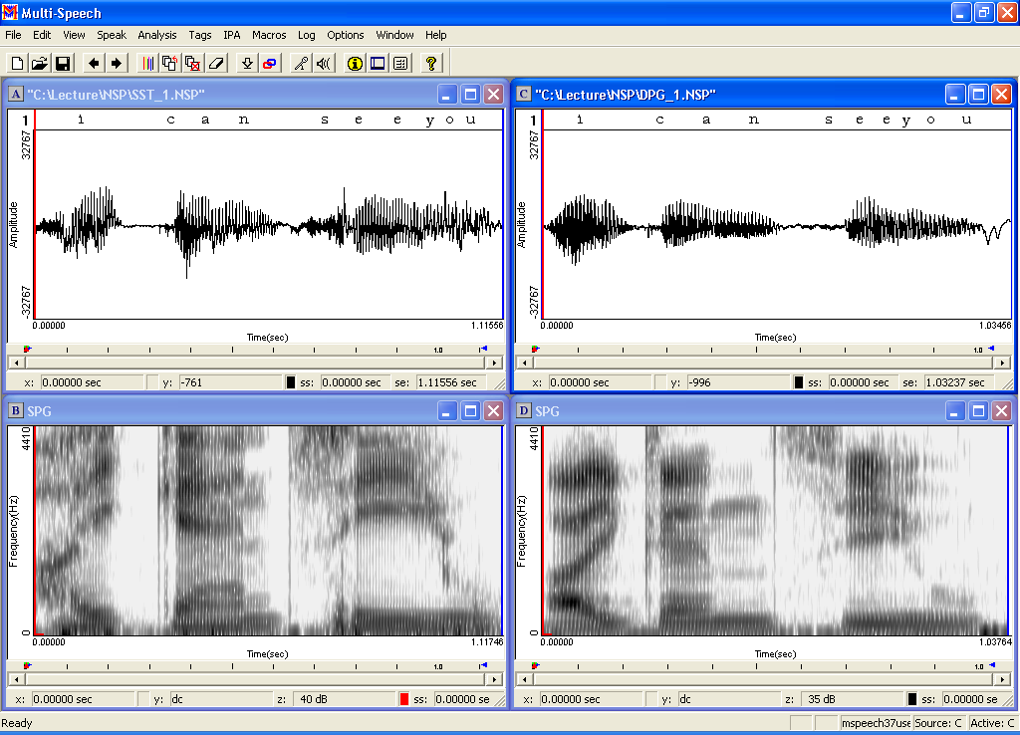
METHODs for Speaker identification
Auditory /Aural examination method
Spectrographically visual-analysis method viz.
    Computerized Speech
    Laboratory (CSL)
    Multi-Speech

Slide 19
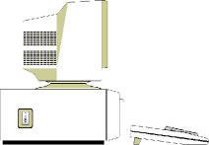

…Continued
Automatic Speaker identification Systems viz.
  Text Independent Speaker Identification System (SPID)
  Language Independent Speaker Identification System (LISIS)
Speech Signal

Slide 20
Audio Examination Tools
Audio High-End Professional System
Digitization Tools
  Professional Audio System
Pre analysis tools
  Goldwave, Adobe Audition, Cool Edit etc.
Analysis Software
  Computerized speech Lab, Multispeech etc.
  Semi Automatic SPID

Slide 21
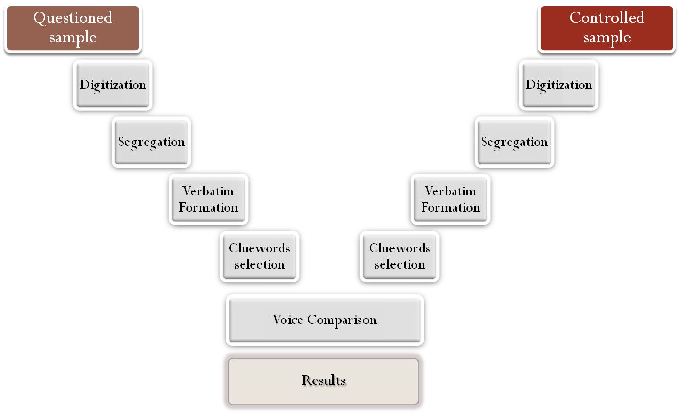
Process of Speaker Identification
Each steps will not compromise any mistake
File format, Sampling rate
After long term memory
Repeated words
Quality clue words
Very much take care of this part
Expert ‘s decision

Slide 22


